Slide 1
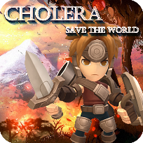
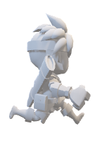
Cholera
CNSCC 210 Group Project Presentation
Group 2
Group Members
Shiwei Gao, Kangcheng Li, Yirun Wang,
Zouzhang Peng, Gaolin Wei, Yuxuan Chen
Notes:
Good afternoon, ladies and gentlemen, welcome to our game introduction.

Slide 2
This is our game, our youth, our try
Notes:
This is our game, our youth, our try.

Slide 3
Contents
Brief Description
4 User Testing and Results
Gameplay and Rules
5 Reflective Evaluation
Implementation Process and Challenges
Notes:
I divided the presentation into 5 parts, they are Description, gameplay and rules, Implementation process and challenges, user testing and results and reflective evaluation.

Slide 4
01
Brief Description
Notes:
Ok, let’s start first part.

Slide 5
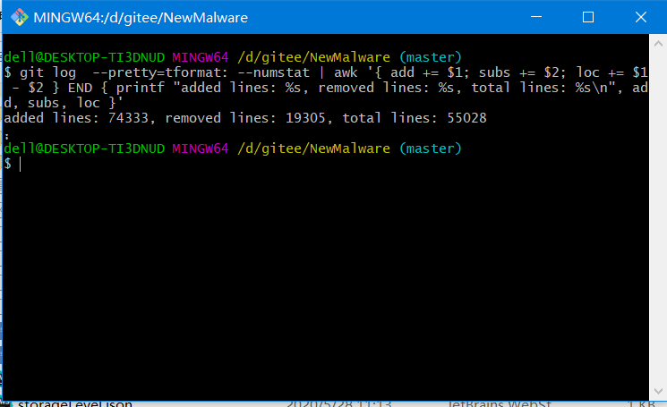
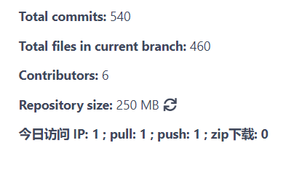
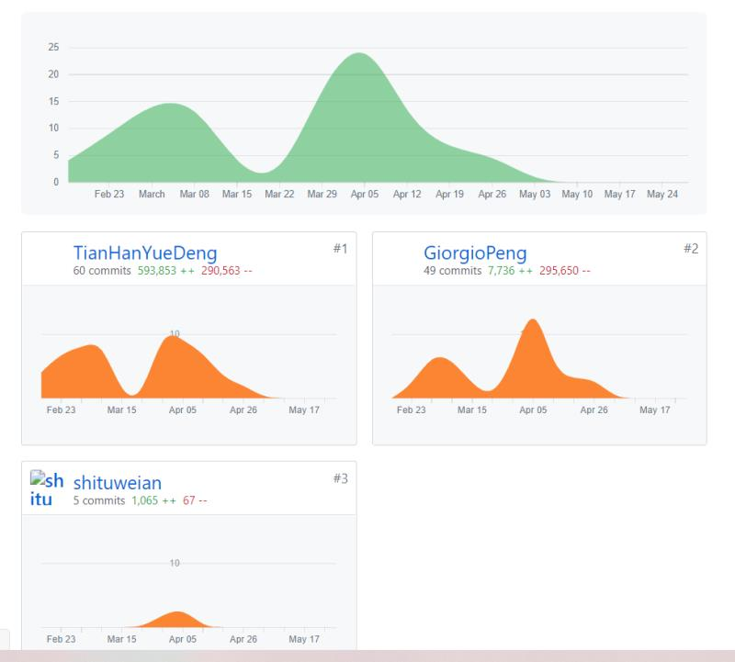
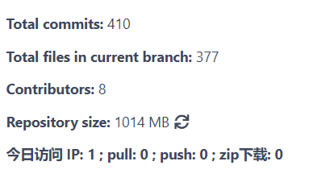
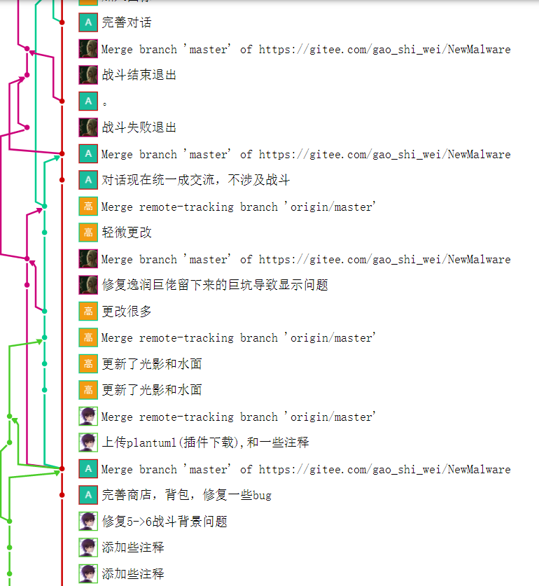
74333-19305=55028 lines
Over 1100 times push
More than 300 classes
Thanks to highly modular, we have had almost no conflicts in the past six months with over 1100 pushes.
Notes:
The whole project contains 75000 lines at the highest time, and after optimizing, our program include 55000 lines now. in the past 6 month, we push over 1100 times, and more than 300 classes were built for this project, thanks to highly modular, we have had almost no conflicts in the past six months with over 1100 pushes.

Slide 6
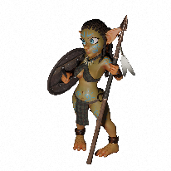
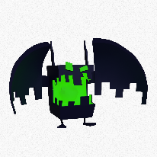
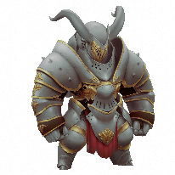
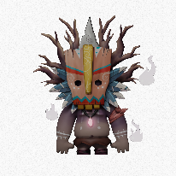
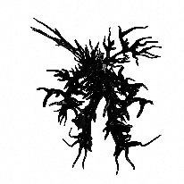
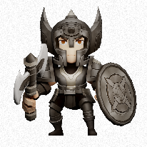
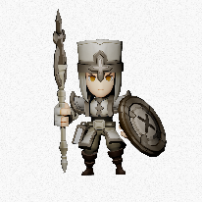
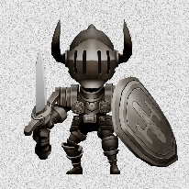
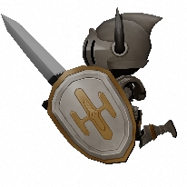
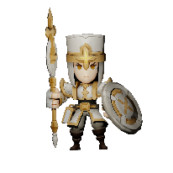
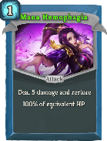
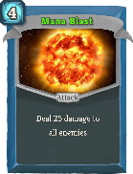
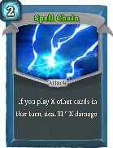
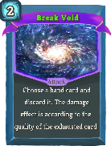
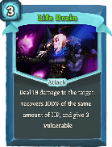
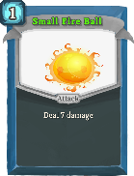
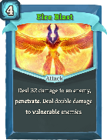
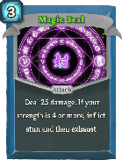
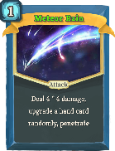
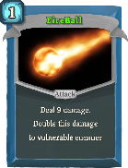
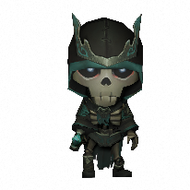
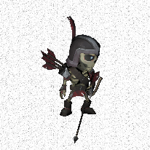
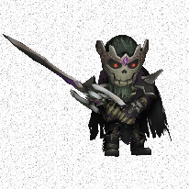
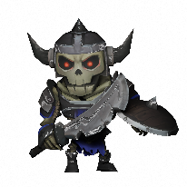
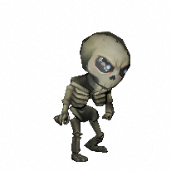
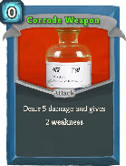
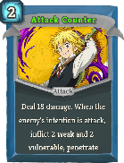
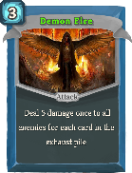
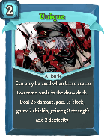
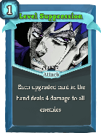
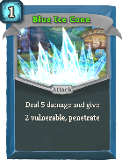
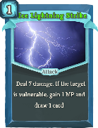
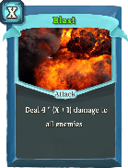
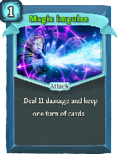
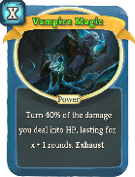
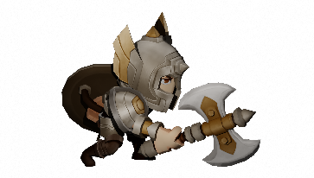
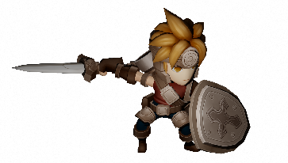
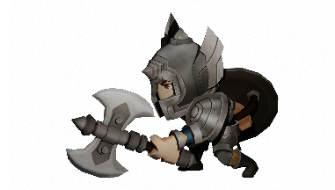
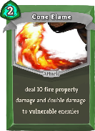
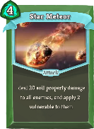
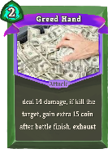
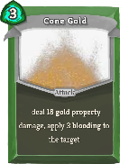
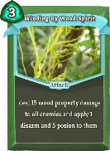













































Over 50 models were modeled for this program.
Almost 300 cards were produced for card fight system.
Notes:
We produced over fifty models for game, you can see here, varies of characters and enemies with different actions. And almost 300 cards were made for card fight system, u can see different types card have different appearance.

Slide 7



We use three months to learn how to use Blender to produce model and how to make actions for characters.
Notes:
We used three months to learn how to use blender to produce model and how to make actions for character.

Slide 8


And we use other three months to learn basic conception of how to build a 3D world. Include how to move character, how to construct game layer, how to import 3D models, how to use JSFML and how to build interact interface.
We generate jar package and exe file, so everyone could have fun to play our game.
We use our own Logo to show this is our game.

Slide 9



The jar program is about 810MB
After generate exe program, it size is 2.13GB

Slide 10
02
Gameplay and Rules

Slide 11


Game Start Panel
Choose to start a new game
Instructions
Choose to load a past game
Choose to quit
Notes:
cyx

Slide 12


Control and Map Choosing Panel
Animation: multiple threads
Choose the chapters
Picture to view the boss and enemies
Information of users choice
All the buttons are stimulated by pictures
Panels to set resolution, frame, anti-aliasing, shadow
Notes:
cyx

Slide 13







We own 6 Maps
Different worlds have different NPCs
Different worlds have different sky
Different worlds have different lights
Notes:
About explore part, we totally have six scenes, different worlds have diverse NPC, sky and lights.

Slide 14







Training knights
Lizard seller
Training soldiers
Beautiful water reflection
Master & Queen
citizen
First Map
citizen
Notes:
This is first map, the first scene is king city which located in an island surrounded by water, u can see beautiful water reflection, these are training knights and soldiers, this is lizard seller, some citizens and these two person is master and queen.

Slide 15






Blue Skeleton
Bat
King of Skeleton
Shaman & his daughter
Angry and Green Skeleton
Blue Skeleton
Second Map
Blue Skeleton
Notes:
The second scene is in a forest, after world were destroyed, prince were transmitted to here, after talking with shaman and his daughter, he knew he need to save the world.

Slide 16





Crab
Boss
Bug Mushroom
Beautiful island
Wreckage
Third Map
Notes:
This is a small island, prince need to clean all enemies under the water.

Slide 17






Skeleton Guard
Strone Monster
Strone Monster
Desert with yellow light
Boss Knight
Forth Map
Red Warrior
Notes:
The forth scene is a desert, in this map, the sky and lights are all yellowing.

Slide 18







Drone
Robot Dog
Robot NPC
Suspended City
Walking Robot
Robot Dog
Fifth Map
Flying Robot
Notes:
The fifth scene is in the core of computer, in this map, prince can jump higher because lose of gravity.

Slide 19





Dark Knight
Stuxnet
Dark Master
Dark King City
Dark Soldier
Sixth Map
Notes:
After the first five scenes, we came back to king city, the sky became evil and light turn to blue, all of our friends turn to dark and we need to defect them.

Slide 20






Press ‘W’ ‘A’ ‘S’ ‘D’ to move the major actor
Press Space to jump,
Fifth world lose gravity so it could jump higher
Press ‘N’ to talk with NPC
Press ‘C’ to change view angle

Slide 21




U can find some chest hidden in the map, the chest would have a music that closer to the sound volume would raise
Touch it to open it, choose a equipment or a card
If you jump into the water or out of map, you will rebirth at the original place

Slide 22








Card
Intro
300+ Cards
Attack Card
Skill Card
Power Card
Cards used to attack enemies, dealing damage and inflicting debuffs meanwhile
Cards used to gain blocks, or weaken enemies.
Cards used to get powerful and lasting effect, strengthening the player in one battle.
Notes:
Wry：Just as previously introduced, our battle consists of cards, equipment, enemies and corresponding battle rule. In these things, cards and equipment can directly decide whether the player can defeat powerful enemies. Let me first introduce the card system. To give an brief overview, we have designed more than 90 cards. There are 4 card rarity level in our game , common, rare, epic and legendary. As you can see here, you can judge them by colour .The more rare the card is, the more powerful the card will be. And There are 3 types of cards, attack card to…. Skill cards to … Power card to… In the battle, you need to play correct card corresponding to the enemies intention. For example, if the enemy tries to attack you, you need to play the skill card to reduce damage. With powerful cards, it will be easy for you to defeat the enemies.

Slide 23



Card
Sample
Here is a card with AOE damage. But what’s more important, this card can change the enemy’s next action, for example. If the enemy wants to attack you, you can use this card. Then the enemy’s next action may become defend itself.
This card can deal the damage equal to your current block. This means you can use many skill cards to gain block before using this card, then this card can deal great damage to the enemy. However, as this card is too powerful, we add exhaust attribute to it. That means, you can only use card once in a single battle.
This card can give the effect lasting for a battle. If an enemy attack you, it will also lose it HP according to the damage it deals.
Notes:
Here I want to introduce you 1 card of each card. As you can see at left. The card in center is called shield bash. Finally, there is a power card called counter strike gesture. There are also many other interesting cards in our game, if you have interest. Try our game and you can find these cards yourself.

Slide 24

























Equipment
Intro
50+ equipment
Good equipment can always strengthen the player.
Notes:
Then let’s come to the equipment part. In general, we have designed about 50 equipment, all with different functions, such as preventing a death, or increasing your MP up limit. Here I listed several icons of these equipment. After you defeat an enemy or pick up a chest, you all have a chance to get an equipment. Picking up more equipment will sure to make the player more powerful.

Slide 25

wda
Equipment
Sample
Myth of Pride
Upgrade all your cards. All your treatment effect will be reduced to 1
Women Clothes
Give a second life to the player by preventing once death
Curse Book
Enemies’ HP will become 1 in next 3 battles
Notes:
Here let my give you 3 example of equipment in our game. As you can see the description, they are all very interesting. You can try and play our game to find more equipment.

Slide 26










Enemy Intro
More than 20 different types of enemies!
Notes:
Pzz：Well, here is time to introduce about the enemies. We designed more than 20 different enemies’ types. Different animals have different characteristics. Because it’s a cholera world, so we use different style when building the model of monsters, some of them are cute, some of them are horrific. But all of them are really good. Besides, we use different voice of different actions or different types of enemies. Also each enemy has his own animations.

Slide 27


Enemy Intro
Stone Man
Final Boss: Stuxnet
Piranhas
stone Mans have high blocks and HP and low damage.
Piranhas can suck blood and always fight with partners
It can heal its HP when its HP is lower than 50%, It can release many kinds buff to itself such as increase strength. It can release some debuffs to the main role such as make the main role be weaker。
Notes:
And I will tell you more detail of the monsters. Most monsters are based on the real world. For example, Piranhas can suck blood and always fight with partners, stone Mans have high blocks and HP and low damage.

Slide 28


Battle Interface
Notes:
This is our battle interface. In the interface you can know some battle information such as the HP, the enemies’ actions, hand cards and so on. and there are some buttons. Clicking end turn button can end this turn , clicking the cards deck button can show you what cards are in your deck and clicking the dropped cards button can show what cards you have used.

Slide 29


Battle Mechanisms
The buffs and debuffs can be divided into several types
1. Permanent (The effect is not affected by the number of turns)
Strength: each strength makes the damage increase one
Dexterity: each dexterity makes the block increase one
Dodge: turn the next damage taken into 1 for x times
Artifact: cancel out the next x debuffs taken
2. Continuous (The effect is affected by the number of turns)
Excite: draw one more card in the next turn, lasting for x turn
Intangible: reduce 50% damage, lasting for x turn
Vulnerable: increase the damage taken from enemies by 50%, lasting for x turn
Weak: decrease the damage by 25%, lasting for x turn
Erode: decrease the block by 1/3, lasting for x turn
Disarm: damage becomes 1 with 33% chance, lasting for x turn
Poison: at the start of each turn, take x damage
Bleeding: every time when attacked to lose HP, take x damage
Stun: can't do anything, lasting for x turn
Notes:
We design the two kinds of buffs, permanent and continuous. And you can see the detail of each buff at this slide.

Slide 30
Battle Lifecycle
Start battle
Start turn
Main role action
End turn
Enemies action
End battle
In each battle, you may meet 1, 2 or 3 enemies. And your aim is use cards to defeat enemies and get the rewards to improve the main role. As you can see, we design the battle lifecycle, and the lifecycle can provide opportunity to trigger equipment. Each turn, user can draw 5 random cards from the cards deck at start turn phase, if the cards deck does not have enough cards, the cards which are in the dropped decks will be added to the cards deck. Also, the magic points will be refreshed at start turn phase. You should consider how to use these magic points carefully. Each turn, the blocks will be reset, you should be more careful of using this point to make some positive influence. After each enemies have finished their actions, their next actions will be random got again. When someone’s HP become 0, the battle will end, there are three different situation: 1. after end the turn, triggering some equipment of card functionality or some debuff like poison and blooding causing damage. 2. the main role uses cards kill the all enemies. 3. the Enemies kills the main role.
Notes:
As you can see, to make the battle logic become clearer, we create this battle lifecycle. Besides, some equipment need be triggered in different phase, which is declared in this lifecycle.

Slide 31



About GUI
Bag System
Players can press B to get bag. In the bag, players can find what equipment and cards they have, also they can see details of every card by pressing it.
Shop System
If players have enough money, they can go to shop to get more powerful skills by pressing G. Players can input the number of goods they want to by and even buy healthy point.
Menu System
Since players want to exit game they can press V to get Menu and press Exit Game. There are some other functions like alpha settings, basic help pages.
Notes:
Wgl：

Slide 32



About GUI
Dialogue
Players can communicate with some NPCs by pressing N
Map
During exploration, players can press M to get map information. There will be a point to represent the location of player.
The blue point represents the location of player.

Slide 33


About GUI
Health point and money
Goods details (include basic info, name, and cost)
Bag
Shop
To input the number want to buy
Check window
Page number

Slide 34
Game Rules
The player should not allow their health value to drop to 0 - if it does the player is considered Dead and needs to restart the game.
The player must kill the boss in each map before they are able to move to the next map.
The player needs to follow the instruction books to play the game.
As the play progresses they will face enemies with higher and higher statistics as well as facing bosses with more powerful abilities. This increase in difficulty gives a fair learning curve while also providing the player with the satisfaction of progress.

Slide 35
03
Implementation Process and Challenges

Slide 36




Model
Issues
Because JME package do not support GLTF or FBX model type, so those models need to be transferred into J3o format, but after transferring, texture and animation disappeared.
Notes:
I wrote some letters to a master who has deep understanding in model and java game, first I asked him some question about texture and how to turn to j3o format, he give me a detailed explain and then I met animation issues, he touched me how to get model’s animation.

Slide 37




How to add Model
In the game?
Because we do not have a visual programming tool, so I wrote two classes, one could generate Axis for whole world to indicate which direction is x and which is y; another class is to get cam’s position so I knew the coordinate of the place I want to add model.

Slide 38



How does major move?
Model collision
Talk with NPC
There is no way to let two character talk with a long distance, so I put a cylinder which is invisible and vertical to the screen, if cylinder touch NPC it means could talk now. cylinder keeps moving with major character.
One model have over 10000 surfaces, so it is impossible to detect all surface’s collision, I use a ellipse to wrap the model, if two ellipse crash, it means two model’s crash.
Because our package have basic conception called “force", so when character want to move, just give him a vector force and play animation.

Slide 39




Because we lack knowledge of texture, so all of our models can not feel the ambient light, in order to fix this problem, I add 6 directional light in every maps, one light might decrease 15 Fps, this way is performance costly.
When we turn to battle state or other scenes, all things need to be removed, it is hard to manage all lights, special effects and models, so I use a ArrayList to control them.

Slide 40
Challenges of JSFML(UI)
It seems that JSFML lacks features to design GUI
(Though JSFML does not has almost all the function to develop control panel, there are also many alternatives to realize it.)
Button can not be found in the library (Replaced with pictures)
The size of the window is unpredictable
Hard to develop a window adapt all the windows size
Other strange bugs(A large part of them are repaired).
I will include several serious problems in the next page.

Slide 41
Challenges of JSFML(UI)
Threads
Multiple thread model one
Multiple thread model two
Main
Main
Main thread start
Second thread start
Main thread
At first, I finish the implement in Linux, when the program is transplanted to Windows, the program collapses soon after start.
Procedures to repair:
remove the multiple threads.
Design the program like model two.
It cost almost one week, the reason is still a mystery.

Slide 42
Challenges of JSFML(UI)
The size of the window will change:
I set the size for the window 1600:900, when my partner tests it, the size became bigger(almost 1080P). Some devices have this problem, some do not.
Solutions: (Also coincidence)
When people select the locked chapter, there will be a swing panel. After that, the size becomes normal. We included some developers information in the swing panel, then let the panel appear when the program start, and everything goes well.
Notes:
I will talk about more seroul part

Slide 43


Challenge 1 of Battle
Logic of Battle
Structure Design
Since our game is a card battle game, it has very complex logic when interacting with the player. For example, how can I implement the card effect, equipment effect ,enemy action when coding? They all have very complex relationship and may interact with each other.
Second one is the structure design, as we have shown before, our source code has more than 50 thousand lines. It a really big project, and the structure of our codes needs to be clear enough for further maintaining.
Memory Leakage
Third one is the memory leakage. Since in our game, we need to always re-draw the picture on the screen, what if we forget to remove the pictures on the screen? Yes, they will keep stuck on the screen forever. That’s because we lose the pointer to the memory of picture, but the memory has not been cleared.
Notes:
Here I encountered many challenge when coding.

Slide 44


Multiple modify at the same time
Challenge 2 of Battle
there is another error which may cause wrong display. As you can see, if we move the mouse on other area, the board we are displayed the actions of each enemy. when we move the mouse on the enemies or on the main character, the board will display the character’s buff. We use two classes to story the main character and the enemies. So if you move the mouse on the enemies, the class of main character try to display the enemies’ actions, however, the class of enemies try to display the enemies buff. Similarly if you move the mouse on the main character, the class of main character try to display the main character’ buffs but the class of enemies try to display the enemies’ actions. So we add a lock to avoid they modified the text of the board at the same time.
Storage opportunity
sometimes you will feel tired if you play the game in a long time, so you can store it and if you want to play the game again you can just load the storage. it’s really cool. Man it’s not too easy to choose a good opportunity to store the game. If we store the game after each battle, there will be some bugs. because it’s possible that we will use some equipment or some cards to modify our deck. If you store the game when the characters moving or jumping, it will cause a huge amount of memory to be used. Hence, we store the game when players get some new cards or equipment automatically. that means players don’t need click a special button or press a special key to store the game, because sometimes the player may forget to store the game, the player will suffer great losses if we don’t have the automatically storage functionality.
Notes:
Also, there are two other challenges.
Because it’s a complex project, it’s possible that some classes try to modify the display content of the screen at the same time. And I use a lock to solve this problem.
To avoid the player forget store the game, the game will be stored automatically, so, the storage opportunity is important. After several attempts, we decided to automatically store when the player get something new.

Slide 45
Challenges about GUI (Lemur)
Poor Documentation
Compatible Problems
Video Problems
Lemur is developed by a Jme amateur. Because of the few contributors of this project. The doc of Lemur is not very clear. And this make us have to read the source code.
Some components from Lemur have some problems. They can not dynamically change size even if they have related methods
Since we try to add some CGs to our game, we have to design the video player ourselves. Because of the 3D, VLCJ has serval problems

Slide 46




About GUI (Lemur)
Notes:
li

Slide 47
Implementation Process
The tasks were chosen by the individuals skill based
We meet every week online to discuss progress and plan ahead
Closer to the deadline we meet at the lab to finish details
Code was tested every time we added a feature
Used GitHub & Gitee during process to keep updated and track versions
Implementation: Who did what
Shiwei: Models with animation, maps exploration, collision & talk logic, effects and lights
Gaolin: GUI systems, storyline trigger, Mini map, Interlude animation
Zouzhang: Battle design, Card design, equipment design, gameplay, storage system
Yirun: Battle design, Card design, gameplay, equipment design, monster feature
Kangcheng: Model initialize, model adjust, GUI design, chest design, test and modify
Yuxuan: Panels design, map design, texture modify
Everyone: Debugging and improvements

Slide 48
04
User Testing and Results

Slide 49



Game Packaging & Game live playing
Use IntelliJ IDEA to export the jar file of the game
Use exe4j Wizard to create the exe file
The game has been uploaded to the cloud disk for users to play
Among 20 audiences watched the game playing
All the game elements are showed in 3 hours
Room popularity exceeds 1000

Slide 50


Questionnaires
30 users tested the game and then filled out a questionnaire
Questions were based around -
The game’s interface
The game’s controls
The game’s difficulty
The game’s ideas and stories
User’s enjoyment

Slide 51


Testing Results
100% of users agreed that this game is enjoyable.
73% of users strongly agreed that they will recommend this game to friends.

Slide 52


Testing Results
70% of users strongly agreed that they can pick up the controls to this game quickly
Most of people can accept our game’s difficulty, while some people may have disagreements.

Slide 53




Testing Results
Almost 70% users think our game has enough elements to keep interests –
Good art design
Creative stories
Playability
Advanced techniques
Notes:
li

Slide 54
05
Reflective Evaluation

Slide 55

Reflective Evaluation: Challenges
We miss a good modeler who has deep understanding for texture and animation, so it costs a lot of time to produce models and modify lights, and lights actually wastes a lot of performance.
The most important things for making 3D game is how to cheat players, for example, I can generate numerous point light in the sky to simulate stars and they can move, but it is performance costly, so we just use a image to cover sky.
Some models and codes are hard to implement, perfection is a Direction, not an option.

Slide 56

For a long time project, we need to plan the time well at the very beginning. We spent too much time on modeling in the early stage, which made everyone tired in the middle stage.
There are too many modules in a project, so the group needs to maintain regular and efficient communication. If the communication is not regular, some modules will be repeated and people cannot understand each other

Slide 57


Reflective Evaluation
Improvement of coding ability
An impressive project experience
Time arrangement
Teamwork spirit
Friendship
Supervisors’ guidance
Game users’ support
Notes:
Thanks to this project, all of our coding ability have improved, this is an impressive project experience, time arrangement and teamwork spirit is important, this program strength our friendship, and without supervisors’ guidance and game users’ support we can not finish this game.

Slide 58



JSFML
JME
LEMUR
Swing
Thanks for Listening
Notes:
Sorry we are little late, but every team member putted all their energies and attentions on this program in past 9 months, and every member responsible for one huge part, so I want show everyone’s work and personal thinking.

